Slide 1
REST
3APIS

Slide 2
3APIS – REST
Course Objectives
By the end of the course, students should:
Understand what is an API
Know about REST
Be able to define an API using OpenAPI
Be capable to query an API
Design REST APIs

Slide 3
Summary
HTTP
REST
OpenAPI

Slide 4
1. HTTP

Slide 5
1. HTTP
Hypertext Transfer Protocol (HTTP) stands as a foundational element of web communication, playing a pivotal role in facilitating the seamless exchange of information between clients and servers on the World Wide Web.
At its core, HTTP operates within the framework of a request-response model. Clients, typically embodied by web browsers, initiate communication by sending requests to servers, which, in turn, respond with the requested data.

Slide 6
1. HTTP
One of the fundamental dynamics of HTTP lies in its adherence to a request-response paradigm.
This approach ensures a structured flow of communication, where clients articulate their needs through requests, and servers meticulously respond with the relevant information.
This standardized interaction forms the backbone of the vast and interconnected landscape of the internet.

Slide 7
1. HTTP
Within the anatomy of an HTTP transaction, several integral components play distinctive roles.
The Uniform Resource Identifier (URI) acts as the identifier, guiding the nature of the transaction by pointing to the specific resource under consideration.
HTTP methods, or verbs, such as GET for retrieval, POST for submission dictate the operation to be executed.

Slide 8
1. HTTP
Headers, carrying metadata, provide additional contextual information about the request or response.
Meanwhile, the body of the transaction encapsulates data, a particularly relevant element in POST requests where information is transmitted from clients to servers.

Slide 9
1. HTTP
HTTP methods, each serving a specific purpose, are the language through which clients communicate with servers. GET retrieves information, POST submits data for processing...
This spectrum of methods encompasses the diverse array of operations conducted in the realm of web communication.

Slide 10
1. HTTP
Status codes, serving as informative signposts, categorize responses into informational, success, redirection, client error, or server error.
These codes offer a concise way to communicate the outcome of a request, guiding both clients and servers through the intricacies of web transactions.

Slide 11
1. HTTP
A distinctive characteristic of HTTP is its statelessness.
Operating as a stateless protocol means that each client-server interaction stands independently, devoid of the server retaining information about previous requests.
This design choice contributes to the simplicity and scalability of the protocol.

Slide 12
1. HTTP
In the realm of security considerations, HTTPS (Hypertext Transfer Protocol Secure) emerges as a significant extension of HTTP.
HTTPS introduces an additional layer of security through SSL/TLS encryption, ensuring secure communication between clients and servers.
This encryption mitigates vulnerabilities associated with unencrypted transmissions, fostering a secure digital environment.

Slide 13
1. HTTP
HTTP, evolving with the changing landscape of technology, has witnessed successive iterations, each bringing enhancements in performance, security, and efficiency.
Versions like HTTP/1.0, HTTP/1.1, HTTP/2, and HTTP/3 reflect the ongoing efforts to refine and optimize the protocol.
HTTP/2, for instance, introduced multiplexing, while HTTP/3 leverages QUIC to further enhance performance.

Slide 14
1. HTTP
This foundational understanding of HTTP is imperative for web developers navigating the intricacies of web communication and interaction.
With a solid grasp of the principles governing HTTP, developers can orchestrate seamless and efficient client-server dynamics, contributing to the robust functionality and interconnectedness of the World Wide Web.

Slide 15
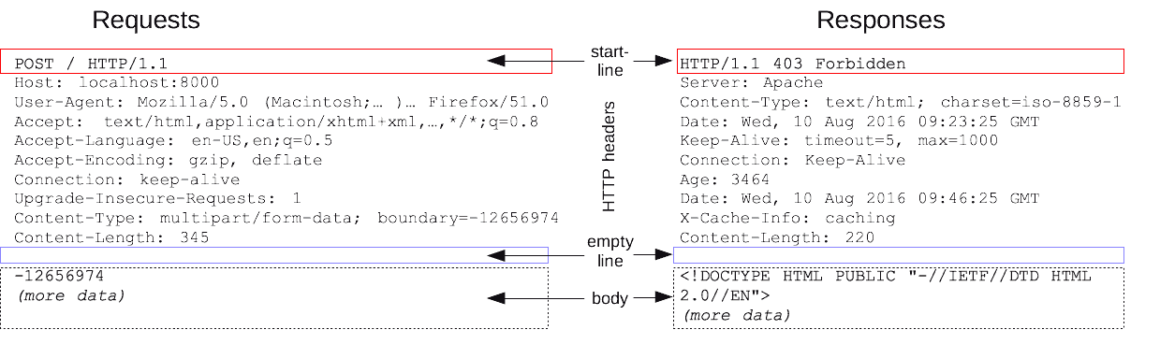
1. HTTP
Resource by MDM

Slide 16
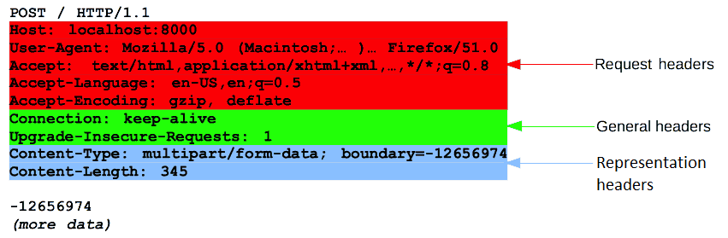
1. HTTP
Resource by MDM

Slide 17
1. HTTP
The request message is composed of multiples parts. You can find more on the W3C RFC
request line
headers
empty line
message body

Slide 18
1. HTTP
The Request line will be composed of
The request method used
The resource URI
The protocol
The version of the protocol

Slide 19
1. HTTP
HTTP defines multiples methods or verbs, currently 9 verbs.
We will mostly focus on the 5 which are the most used when building a web applications on the web but you can encounter some other depending on your use case.
HTTP methods, also known as verbs, represent the actions that can be performed on a resource identified by a Uniform Resource Identifier (URI).
Each method has a specific purpose, and they play a crucial role in defining the nature of the interaction between a client (such as a web browser) and a server. Here's an explanation of some common HTTP methods:

Slide 20
1. HTTP
GET
Used to retrieve information from the specified resource.
The GET method is idempotent, meaning multiple identical requests should have the same effect as a single request. It is also safe, indicating that it should not have a significant impact on the resource.

Slide 21
1. HTTP
POST
Used to submit data to be processed to a specified resource.
The POST method is not idempotent, meaning multiple identical requests may have different effects. It is often employed when uploading a file, submitting a form, or when the outcome of the request depends on the state of the server.

Slide 22
1. HTTP
PUT
Used to update a resource or create it if it does not exist.
Similar to POST, but the PUT method is idempotent, meaning repeated requests have the same effect. It is often employed when updating the content of an existing resource.

Slide 23
1. HTTP
DELETE
Used to request the removal of a resource.
The DELETE method is idempotent, meaning repeated requests have the same effect. It is employed when a client wants to delete a specified resource on the server.

Slide 24
1. HTTP
PATCH
Used to apply partial modifications to a resource.
The PATCH method is not idempotent, meaning multiple identical requests may have different effects. It is employed when the client wants to apply partial modifications to a resource.

Slide 25
1. HTTP
OPTIONS
Used to describe the communication options for the target resource.
The OPTIONS method is often used to request information about the communication options available on the target resource, such as which methods are supported.

Slide 26
1. HTTP
HTTP status codes are three-digit numbers returned by a server in response to a client's request made to the server.
They provide information about the status of the request and the outcome of the server's attempt to process it.
Status codes are divided into different classes, each indicating a specific category of response.

Slide 27
1. HTTP
1xx Informational
These are informational status codes indicating that the request was received, continuing process, or waiting for further action.
Example:
100 Continue: The server has received the initial part of the request, and the client can continue with the rest.

Slide 28
1. HTTP
2xx Success
These indicate that the request was successfully received, understood, and accepted.
Examples:
200 OK: The request was successful, and the server has returned the requested data.
201 Created: The request was successful, and a new resource was created as a result.
204 No Content: The server successfully processed the request but is not returning any content.

Slide 29
1. HTTP
3xx Redirection
These indicate that further action is needed to complete the request. The client might need to redirect to a different location or use a different method.
Examples:
301 Moved Permanently: The requested resource has been permanently moved to a different location.
302 Found (or 307 Temporary Redirect): The requested resource has been temporarily moved to a different location.

Slide 30
1. HTTP
4xx Client Error
These indicate that the client seems to have made an error or the request cannot be fulfilled by the server.
Examples:
400 Bad Request: The server could not understand the request due to malformed syntax or invalid request message framing.
401 Unauthorized: The client must authenticate itself to get the requested response.
403 Forbidden: The client does not have permission to access the requested resource.
404 Not Found: The server cannot find the requested resource

Slide 31
1. HTTP
5xx Server Error
These indicate that the server failed to fulfill a valid request.
Examples:
500 Internal Server Error: A generic error message indicating an unexpected condition encountered by the server.
502 Bad Gateway: The server, while acting as a gateway or proxy, received an invalid response from an upstream server.
503 Service Unavailable: The server is not ready to handle the request. Common causes include temporary overloading or maintenance.

Slide 32

Exercises

Slide 33
2. REST

Slide 34
2. REST
REST, or Representational State Transfer, is an architectural style for designing networked applications.
It was introduced by Roy Fielding in his doctoral dissertation titled "Architectural Styles and the Design of Network-based Software Architectures" which he presented in 2000.
Fielding's dissertation played a significant role in shaping the foundation of RESTful architecture.

Slide 35
2. REST
The dissertation outlined the principles and constraints of RESTful architecture.
Fielding's work was based on his experiences with designing and implementing the HTTP/1.1 and URI standards.
REST has since become a widely adopted architectural style for designing scalable and interoperable web services.
Its principles have influenced the development of web APIs and have become a cornerstone in building distributed systems that prioritize simplicity, scalability, and flexibility.

Slide 36
2. REST
The REST architectural style defines six guiding constraints.
When these constraints are applied to the system architecture, it gains
desirable non-functional properties, such as performance, scalability,
simplicity, modifiability, visibility, portability, and reliability.
A system that complies with some or all of these constraints is loosely
referred to as RESTful.

Slide 37
2. REST
Client-Server Architecture
The client and server are separate entities that communicate over a network.
The client is responsible for the user interface and user experience, while the server manages resources, processes requests, and contains the business logic.
This separation allows for independent evolution of both client and server components.

Slide 38
2. REST
Statelessness
Each request from a client to a server must contain all the information needed to understand and fulfill the request.
The server does not store any client state between requests. This constraint enhances scalability and simplifies the client-server interaction.

Slide 39
2. REST
Cacheability
Responses from the server can be explicitly marked as cacheable or non-cacheable.
Cacheable responses improve efficiency by allowing clients to reuse previously fetched representations, reducing the need for repeated requests to the server.

Slide 40
2. REST
Uniform Interface
The uniform interface is a central constraint in REST and is further divided into four sub constraints:
Resource Identification: Resources are identified by URIs (Uniform Resource Identifiers).
Resource Manipulation through Representations: Resources can be manipulated using standard, stateless operations, and the representation of a resource is separate from the resource itself.
Self-Descriptive Messages: Each message between client and server contains enough information for the recipient to understand and process the message.
Hypermedia as the Engine of Application State (HATEOAS): Clients interact with the application entirely through hypermedia provided dynamically by application servers.

Slide 41
2. REST
Layered System
A RESTful architecture can be composed of multiple layers, where each layer has a specific set of functionality.
Each layer is unaware of the layers above and below it, promoting flexibility and simplifying the architecture.

Slide 42
2. REST
Code on Demand (Optional)
This constraint is optional, and it allows the client to download and execute code, such as JavaScript, from the server.
While not a mandatory constraint, it can enhance the functionality and flexibility of the client, especially in web applications.

Slide 43
2. REST
SOAP (Simple Object Access Protocol) and REST (Representational State Transfer) are distinct approaches to web service design.
SOAP is a protocol with standardized specifications, using XML as its message format, making it suitable for enterprise-level applications that demand a formal contract between client and server.
In contrast, REST is an architectural style, often chosen for its flexibility and simplicity, using various formats like JSON or XML.

Slide 44
2. REST
RESTful services are inherently stateless, making them lightweight and scalable, ideal for web and mobile applications.
While SOAP follows a request-response communication style and supports both stateful and stateless interactions, REST adopts a resource-oriented communication style, emphasizing standard HTTP methods for CRUD operations and finding popularity in scenarios prioritizing simplicity and quick development cycles.

Slide 45
2. REST
The three levels of a REST API, often categorized based on their adherence to REST principles, are described as follows:
RESTful
REST
HATEOAS

Slide 46
2. REST
RESTful
APIs at this level are based on URLs and typically utilize the HTTP methods GET and POST.
This level represents a basic adoption of REST principles, with resources identified by URIs and actions performed through simple HTTP operations.

Slide 47
2. REST
REST
APIs classified as REST adhere to the full set of rules for all HTTP methods, including GET, POST, PUT, and DELETE.
This level emphasizes the comprehensive application of REST principles, ensuring uniformity in the design of resources and interactions, such as the proper use of HTTP status codes and adherence to statelessness.

Slide 48
2. REST
HATEOAS (Hypermedia as the Engine of Application State)
At this advanced level, APIs not only follow REST principles but also fully respect the REST architectural style, especially the Uniform Interface Constraint (UIC) with the auto-discoverable aspect.
HATEOAS allows clients to interact with the application entirely through dynamically provided hypermedia, enabling navigation based on the available actions in the current state.

Slide 49
2. REST
These levels represent a progression in the extent to which APIs adhere to REST principles, starting from basic adoption (RESTful) to full adherence (REST) and culminating in advanced implementation (HATEOAS) with a focus on hypermedia-driven navigation.

Slide 50
Exercises

Slide 51
3. OpenAPI

Slide 52
3. OpenAPI
OpenAPI, formerly known as Swagger, is an open standard for defining and documenting APIs.
It provides a standardized way to describe RESTful APIs, allowing both humans and computers to understand the capabilities of a service without access to its source code.
OpenAPI specifications are written in JSON or YAML and serve as a contract that outlines the structure of requests and responses, available endpoints, and other essential information.

Slide 53
3. OpenAPI
At the heart of OpenAPI lies its Specification (OAS), serving as a comprehensive definition of the API's architecture.
Developers leverage the Swagger Editor for real-time validation and to create and modify OpenAPI specifications.
This editor is instrumental in generating the API documentation, which becomes interactive and easily accessible through tools like Swagger UI.

Slide 54
3. OpenAPI
A notable feature of OpenAPI is its support for automatic code generation.
Developers can employ the specifications to automatically generate client libraries, server stubs, and API documentation, fostering consistency throughout the development lifecycle.
The interoperability fostered by OpenAPI ensures that APIs adhering to its specifications can seamlessly integrate with diverse tools and platforms.

Slide 55
3. OpenAPI
One of the significant advantages of OpenAPI is its inherent ability to streamline documentation.
The self-contained nature of the specifications enables API consumers to navigate and comprehend the API's intricacies without having to consult separate documentation.
Additionally, OpenAPI boasts a vibrant ecosystem of tools supporting various facets of API development, testing, and documentation, enhancing overall productivity.

Slide 56
3. OpenAPI
In essence, OpenAPI emerges as a fundamental element in contemporary API development, providing a standardized, machine-readable format.
It not only simplifies the design and documentation of APIs but also promotes collaboration and interoperability across a diverse range of tools and platforms, making it a cornerstone in modern API development practices.

Slide 57
3. OpenAPI
The synergy between OpenAPI, Swagger, and the Linux Foundation underscores a commitment to open standards, collaboration, and the evolution of API development practices.
Together, they form a powerful alliance that not only simplifies the process of designing, documenting, and consuming APIs but also advances the broader goals of openness and innovation within the Linux and open-source community.
This collaboration is poised to leave a lasting impact on the landscape of API development, promoting consistency, interoperability, and community-driven excellence.

Slide 58
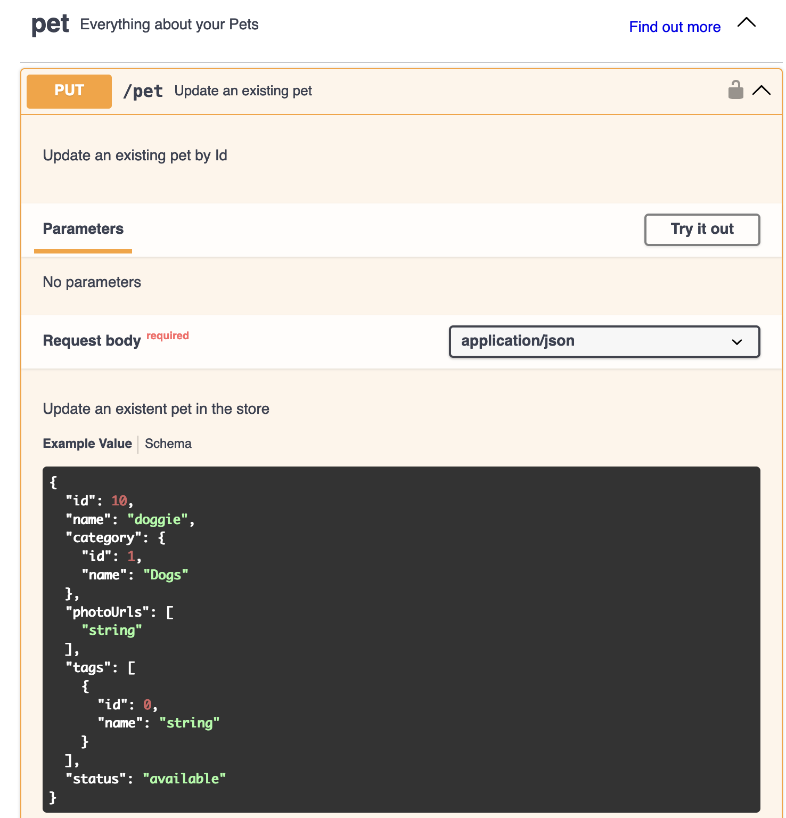
3. OpenAPI
Example of a Swagger UI
interface, with a random
project.
It displays the method
and URL, the list of the
parameters expected in
the body

Slide 59
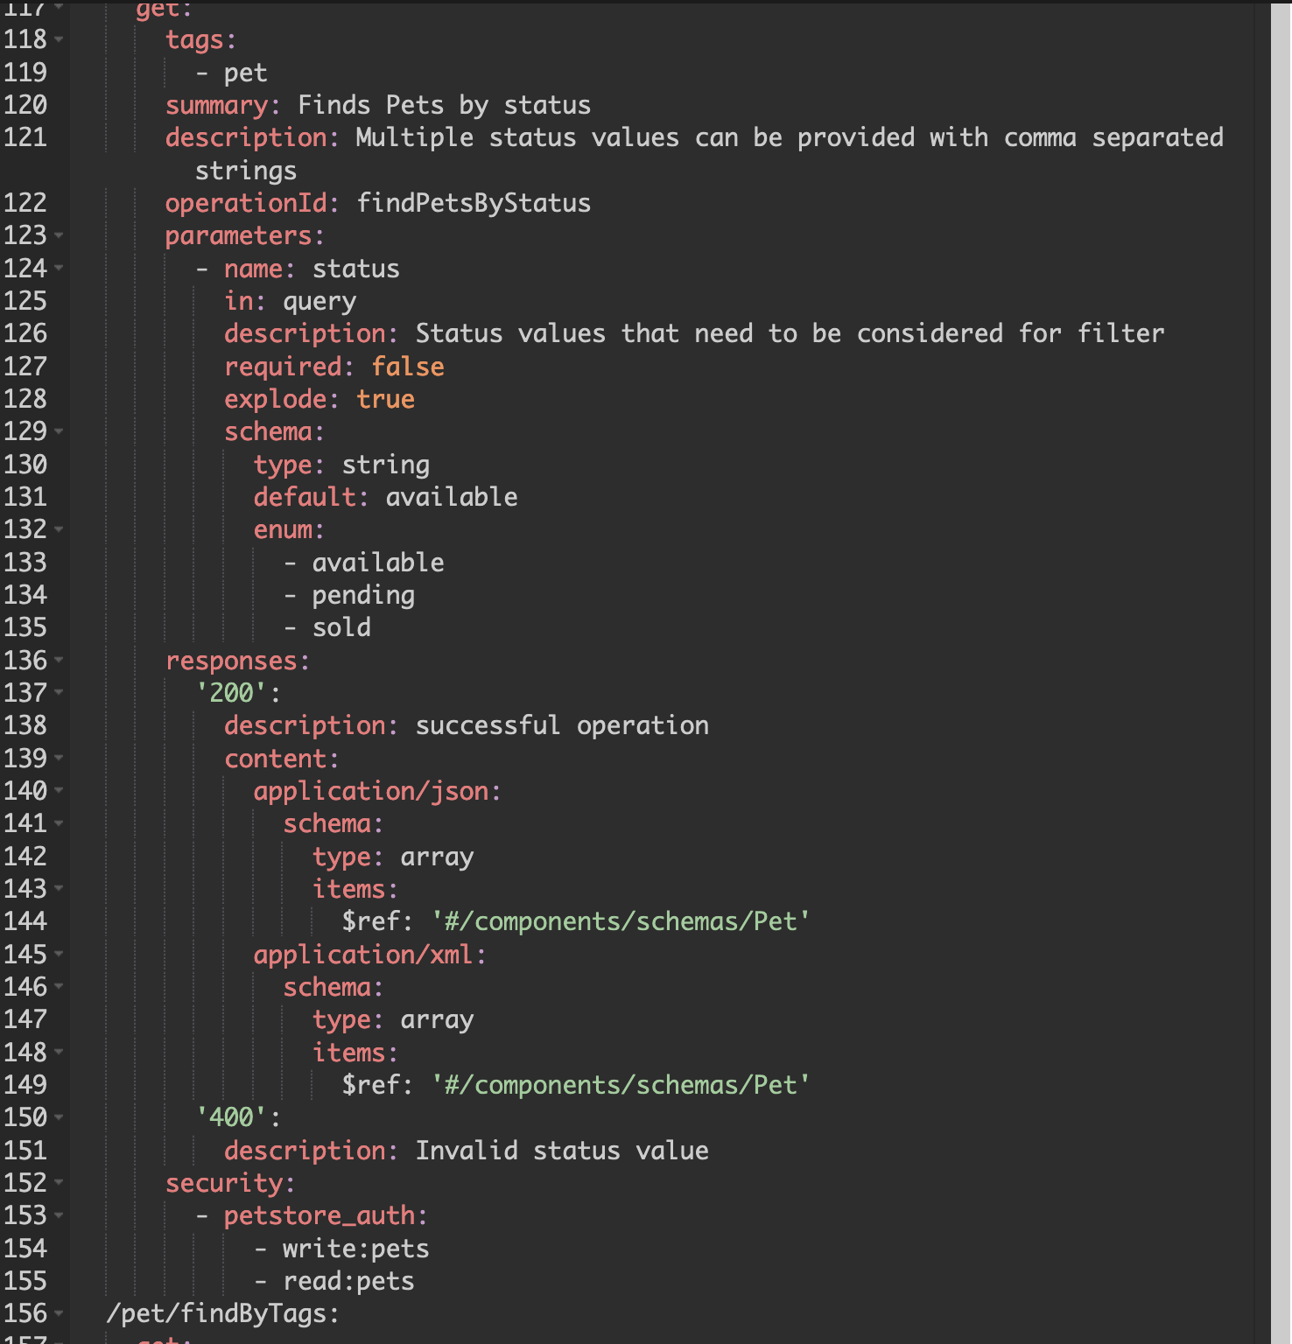
3. OpenAPI
The code used to
generate the previous
example. In this case, YAML has
been used, but JSON is
also compatible.
You can define
parameters, responses
and more.

Slide 60
Exercises

